Slide 1
GRAPH-BERT: Only Attention is Needed for Learning Graph Representations
汇报人：Tang gu
时间：2020.9.24

Slide 2
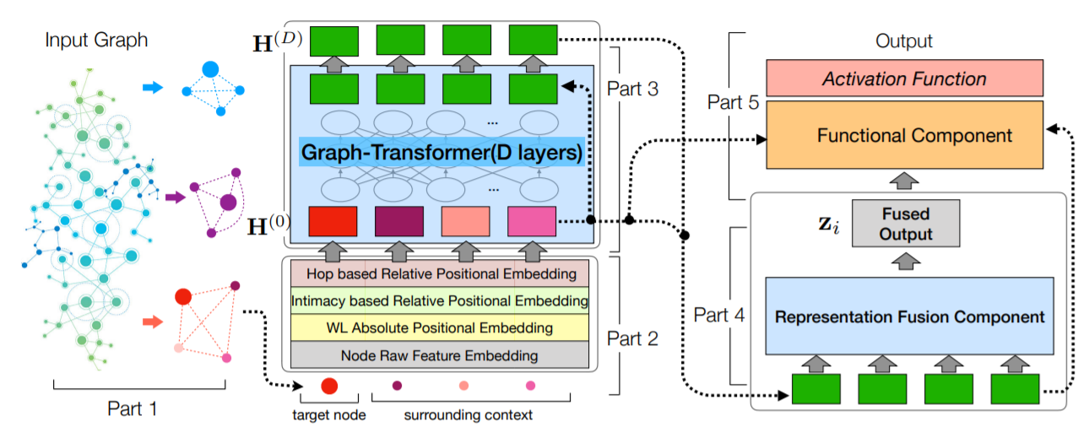
Backgroud
Normal GCN question I: Suspended animation will occur when the model layer is deepened
Normal GCN question II:Excessive smoothing occurs when the number of model layers is deepened

Slide 3
Pretrain Graph-Bert-First step
Decompose the original graph into unbounded subgraphs (without considering the edge information in the subgraphs)

Slide 4
Pretrain Graph-Bert-Sencond step

Slide 5
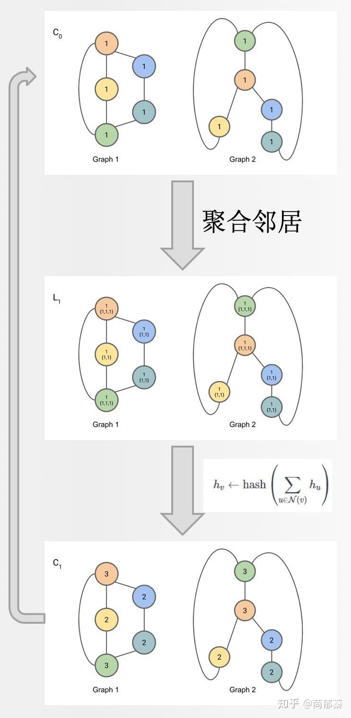
Weisfeiler-Lehman Absolute Role

Slide 6
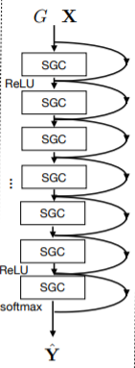
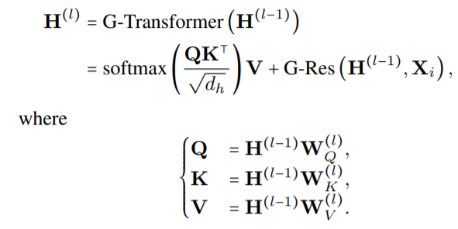
Pretrain Graph-Bert-Third step

Slide 7
Pretrain Graph-Bert-Fourth step
Avg-pooling

Slide 8
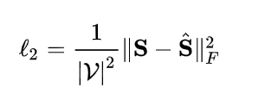
First-step-extract sentiment words

Slide 9
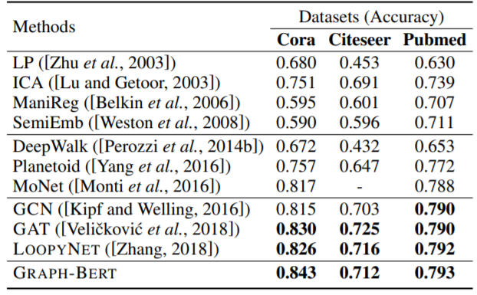
Dataset and Experiments

Slide 10
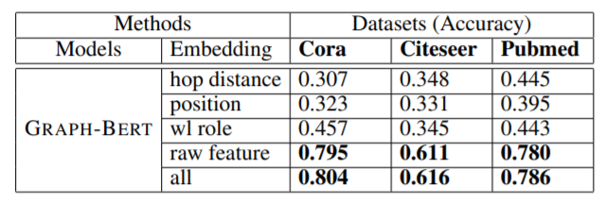
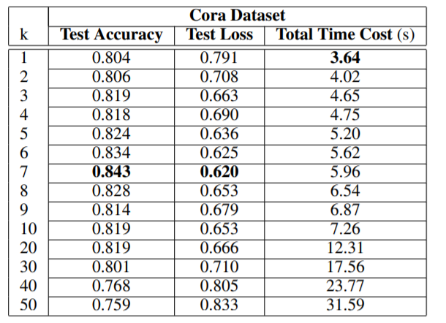
Dataset and Experiments

Slide 11
THANGKS!

